Slide 1
FOREX Rate Prediction
Capstone Project
Abhinav Pandey

Slide 2
Dataset
Available in the form of a csv file. Source - https://www.rba.gov.au/statistics/historical-data.html
Contains daily exchange rates of 35 currencies against the Australian Dollar (AUD), including USD, JPY and GBP from Jan 1984 to Feb 2020.

Slide 3
Problem Statement
Can we predict one month into the future for any given currency pair using the last 2 years of daily FOREX rates?
Thus the data has been split accordingly –
Training : contains USD/AUD rates from 2017 and 2018
Validation : contains USD/AUD rates in 2019
Test : contains USD/AUD rates from Jan 2, 2020 to Feb 8, 2020

Slide 4
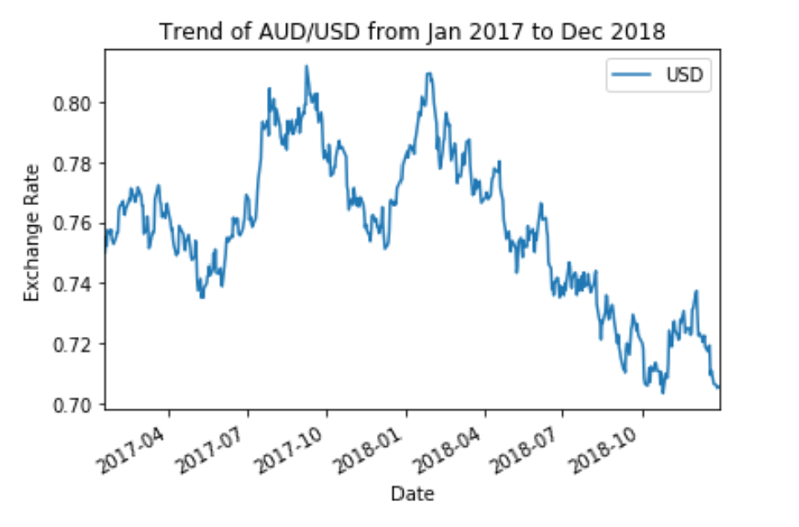
Training Data

Slide 5
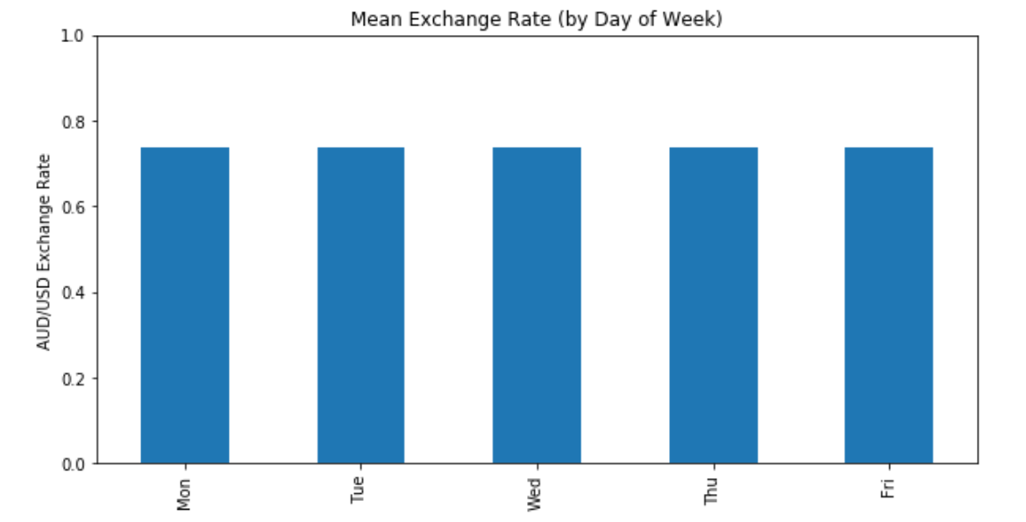
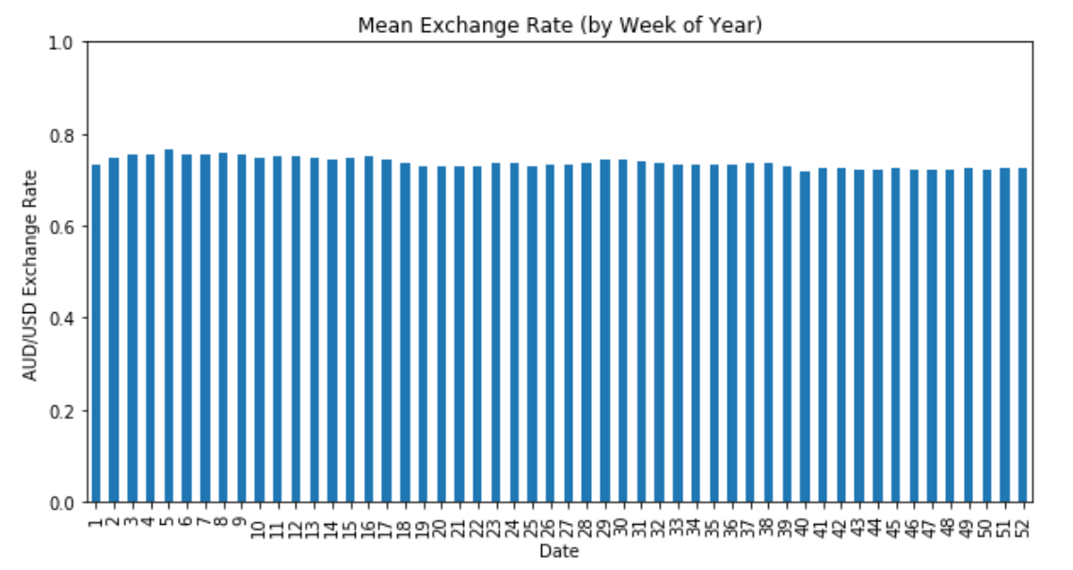
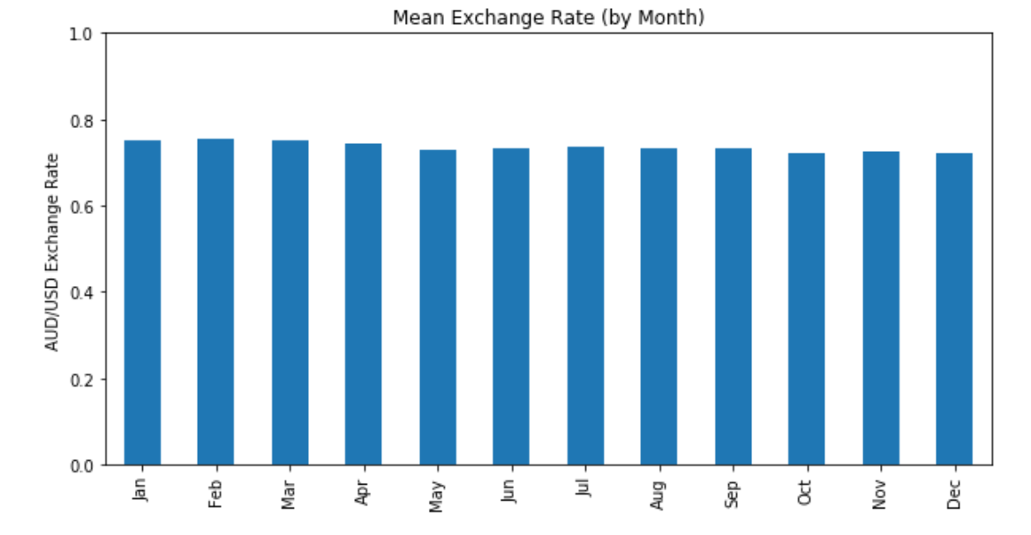
Which days, weeks, months have the highest/lowest rates on average? (2017 to 2019)

Slide 6
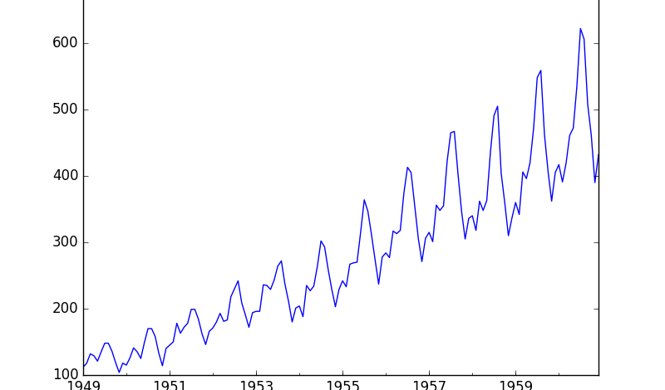
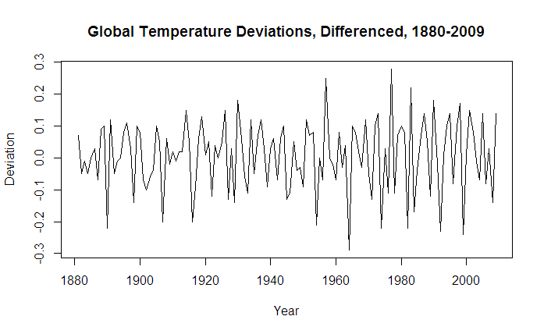
Inspecting Stationarity of Time Series
Not Stationary
What is a stationary time series?
A stationary time series is one whose statistical properties such as mean, variance, autocorrelation, etc. are all constant over time.
Stationary

Slide 7
Two ways we’ll be checking for stationarity
Visual Inspection by looking at plots
Hypothesis Testing (Augmented Dicky-Fuller Test)

Slide 8
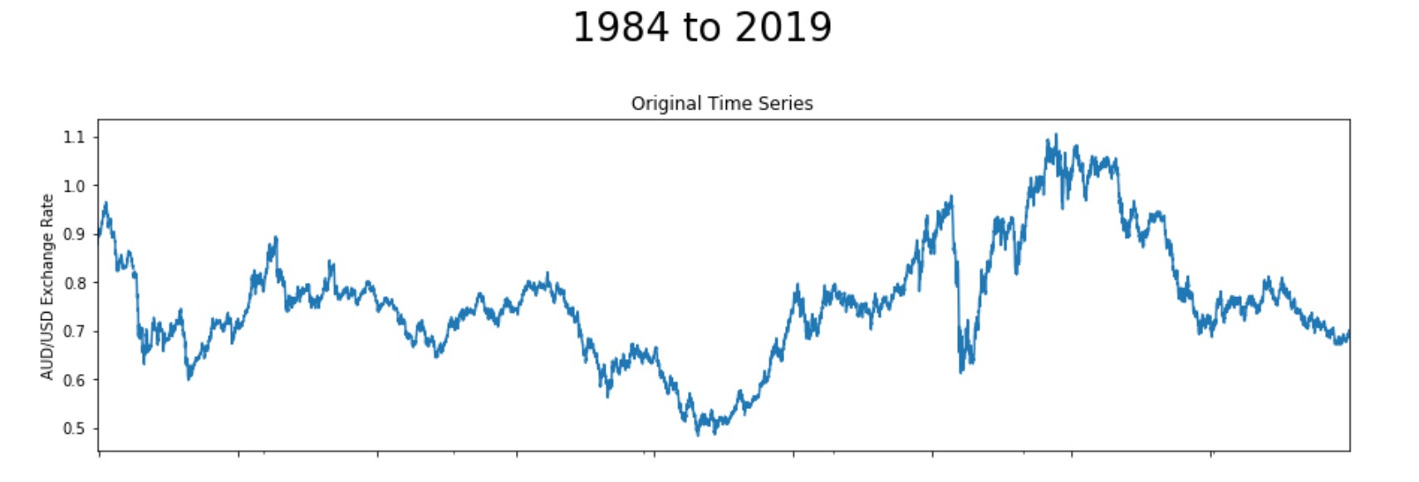
USD/AUD Exchange Rate since 1984
Not Stationary

Slide 9
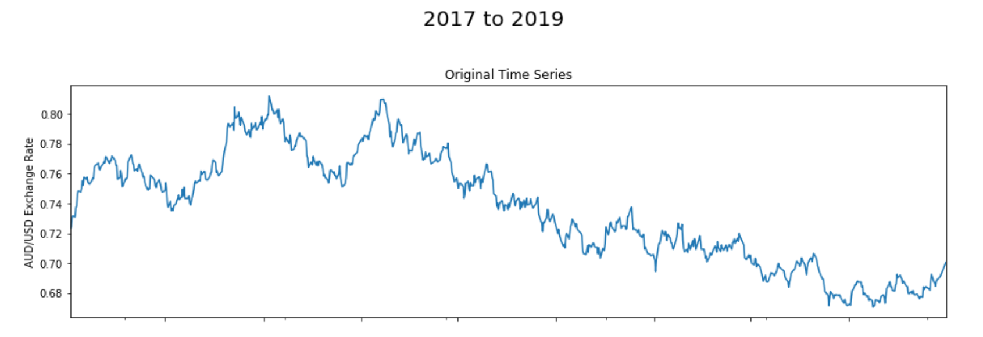
USD/AUD Exchange Rate (Training Data)
Not Stationary

Slide 10
Two ways we’ll be checking for stationarity
Visually
Hypothesis Testing (Augmented Dicky-Fuller Test)

Slide 11
Augmented Dicky Fuller (ADF) Test
The ADF test is a type of statistical test.
Null Hypothesis (H0): If failed to be rejected, it suggests the time series is non-stationary. It has some time dependent structure.
Alternate Hypothesis (H1): The null hypothesis is rejected; it suggests the time series is stationary. It does not have time-dependent structure.
p-value > 0.05: Fail to reject the null hypothesis (H0), the data has a unit root and is non-stationary.
p-value <= 0.05: Reject the null hypothesis (H0), the data does not have a unit root and is stationary.

Slide 12
Is our dataset stationary? (1984 to 2019)
p-value: 0.174215
ADF Statistic: -2.293064
Critical Values:
1%: -3.431
5%: -2.862
10%: -2.567
Not Stationary

Slide 13
Is our Training data stationary?
Not Stationary
p-value: 0.174215
ADF Statistic: -2.293064
Critical Values:
1%: -3.431
5%: -2.862
10%: -2.567

Slide 14
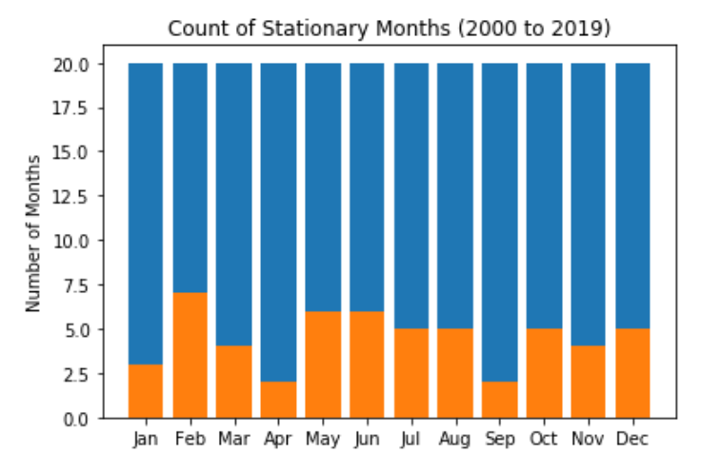
Some months show stationary characteristics

Slide 15
Using transformations to make the dataset stationary
1. Log Transform
2. Square Root Transform
3. Proportional Change Transformation
4. Log Returns
5. First Differencing (Returns)

Slide 16
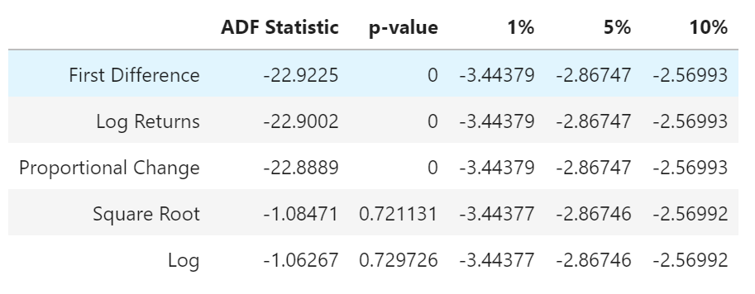
ADF Test of the Transformation Results

Slide 17
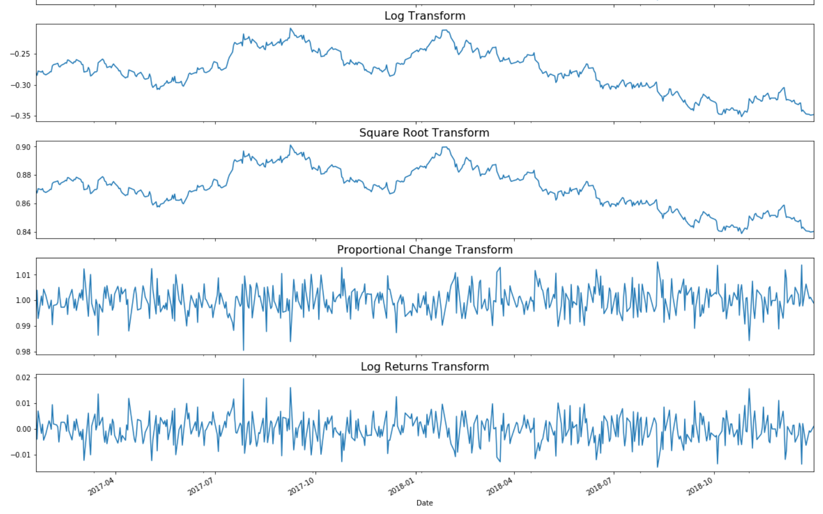
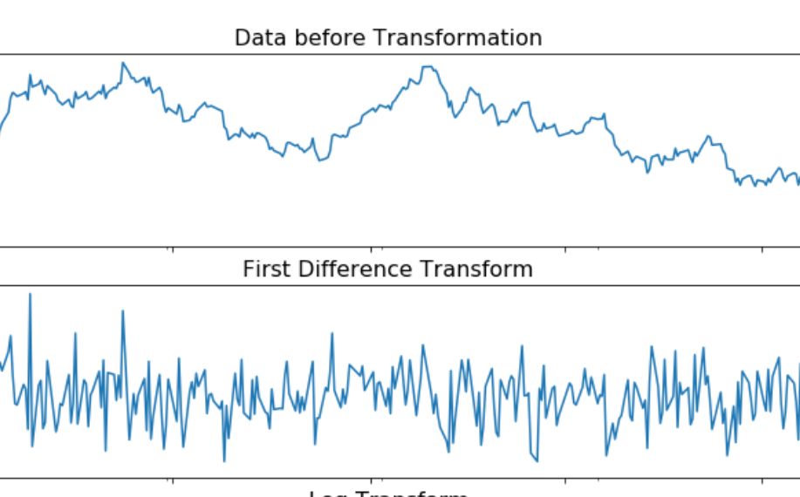
Visualising Transformations

